Slide 1
Food trend in metro manila
By: hermie dalay
Applied Data Science Capstone by Coursera.

Slide 2
introduction
Filipinos fondness for eating-out accelerated the proliferation of food service businesses in the Philippines; from fast food chains, cafeterias, restaurants, and eat-all-you-can buffets especially in the big cities within Metro Manila. For the lack of general term and for simplicity, we will refer to all food service establishments as “restaurants” which include both sit-down establishments and fast-food outlets.

Slide 3
1.1 Problem
Starting a new restaurant is lucrative yet a tricky business venture. We often see an opening of a new coffee shop only to see them closing down after only a year or two. Some don’t even get to celebrate their 1st year anniversary. It is said that restaurant business is all about location, location, location. I agree, but one more thing is as important as the location, the CONCEPT. One can be at the best prime location in a big city, but with the wrong concept, success may not see fruition. Thus, finding the best location for the right food concept is important before venturing to a new food business.

Slide 4
1.2 Objective
The objectives of this project is as follows:
To determine the most common restaurant themes, know the food trend in Metro Manila.
To determine the popular locations in each city of Metro Manila.

Slide 5
2. data
With this project, we will be extracting data utilizing Foursquare API to get business profiles and information of existing food service related businesses in the cities of Metro Manila in the Philippines. We will also be needing the geographical location of Metro Manila cities.

Slide 6
2.1 Data acquisition
2.1.1 Geographical location data of cities in Metro Manila, Phillipines through the internet
2.1.2 Venues from Foursquare API

Slide 7
3. methodology

Slide 8
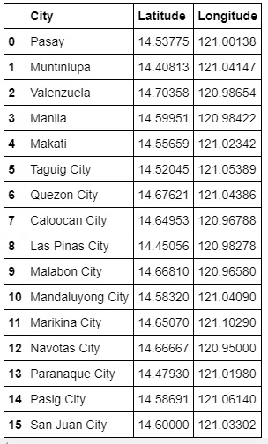
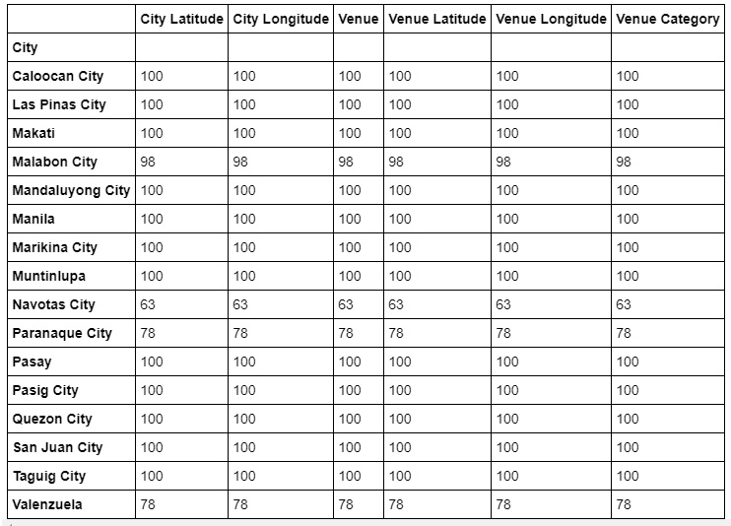
3.1.1 locations
3.1.2 venues - summary

Slide 9
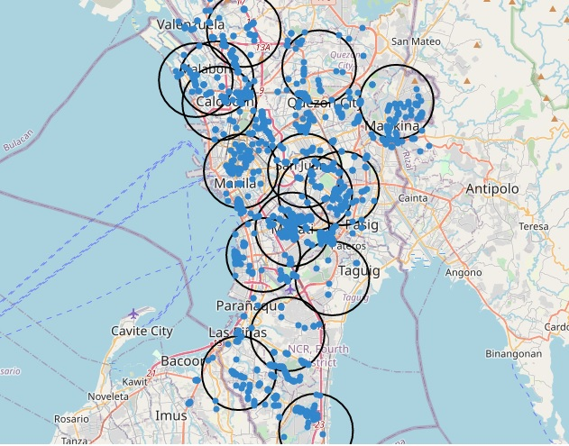
3.2 Venues in metro manila

Slide 10
3.3 exploratory data analysis
One hot encoding
Data wrangling and simplification
K-means clustering

Slide 11
4. results

Slide 12
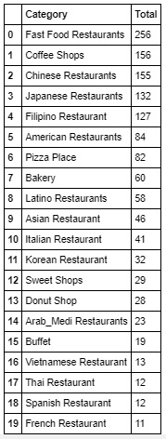
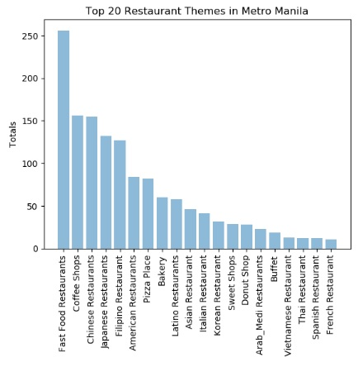
4.1 top 20 restaurants category in metro manila

Slide 13
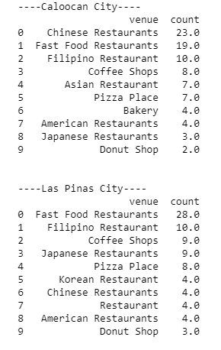
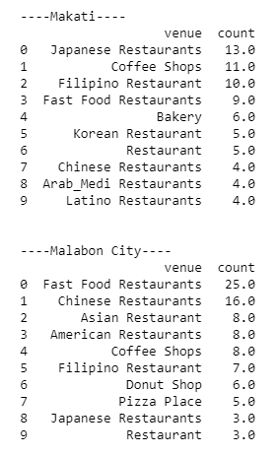
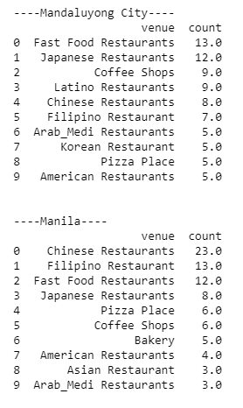
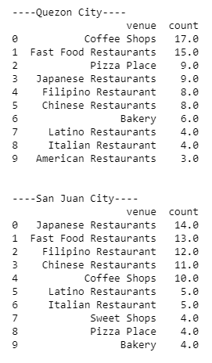
4.2 top 10 for each city

Slide 14
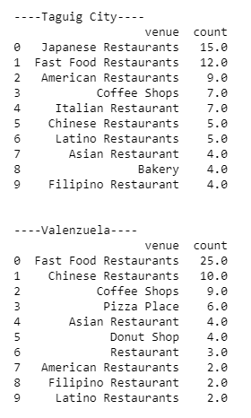
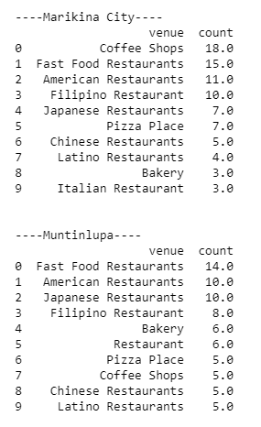
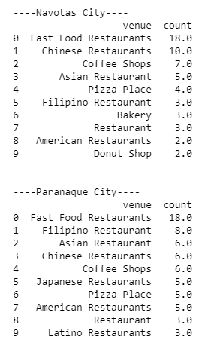
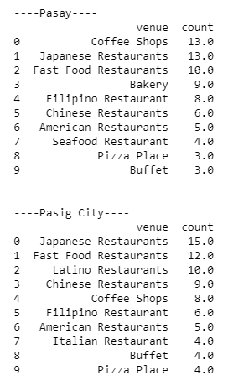
4.2 top 10 for each city

Slide 15
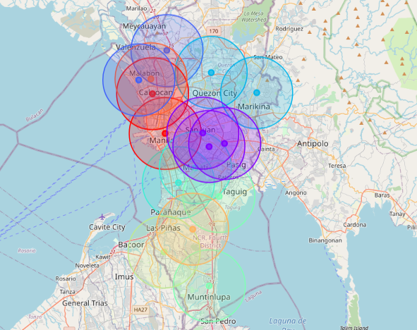
4.2 map with clustered cities

Slide 16
5. discussion
OBSERVATIONS
Fast Food is number one
Japanese Restaurants in business districts
Coffee is sweet in BPO areas
Go Chinese in China Town
I love Filipino in International Airports
RECOMMENDATIONS
Fast Food Anywhere
Japanese and Café in Business Districts
Chinese and Filipino Restaurants in Northwestern side of Metro Manila

Slide 17
6. conclusion
In conclusion, fast food restaurants are the most common category of food service business in the whole Metro Manila. Other categories are strong in some cities but weak in others. So, it is important to know what category is more appropriate in certain city.

